Slide 1

FERGUSSON COLLEGE (AUTONOMOUS) , PUNE.
Computer Science Department Applied Linear Algebra:CE-2
NAME:ADITYA DUMBARE.
ROLL_NO:226502.
Class:F.Y.M.sc(Data Science).

Slide 2
Topic Name: K-Means Clustering On World Economic Data
Data Collection:
https://www.Kaggle.com
https://www.kaggle.com/datasets/madhurpant/world-economic-data

Slide 3
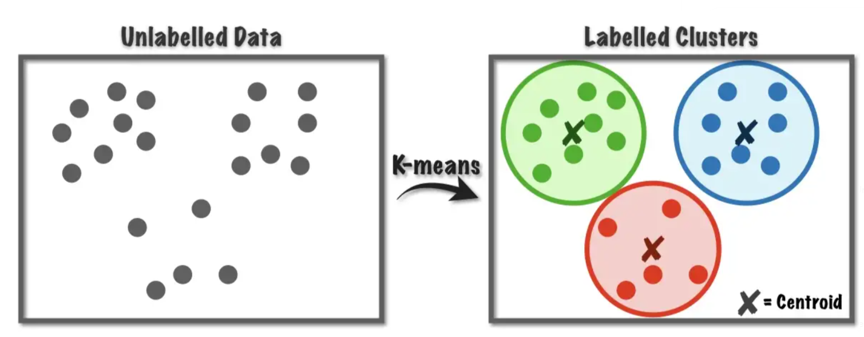
Clustering:
Clustering is the task of dividing the data points into a number of groups such that data points in the same groups are more similar to other data points in the same group than those in other groups.
K-Means Clustering:
K-means clustering is a simple unsupervised learning algorithm that is used to solve clustering problems. It follows a simple procedure of classifying a given data set into a number of clusters, defined by the letter “K”.

Slide 4
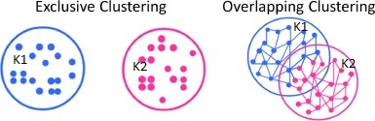
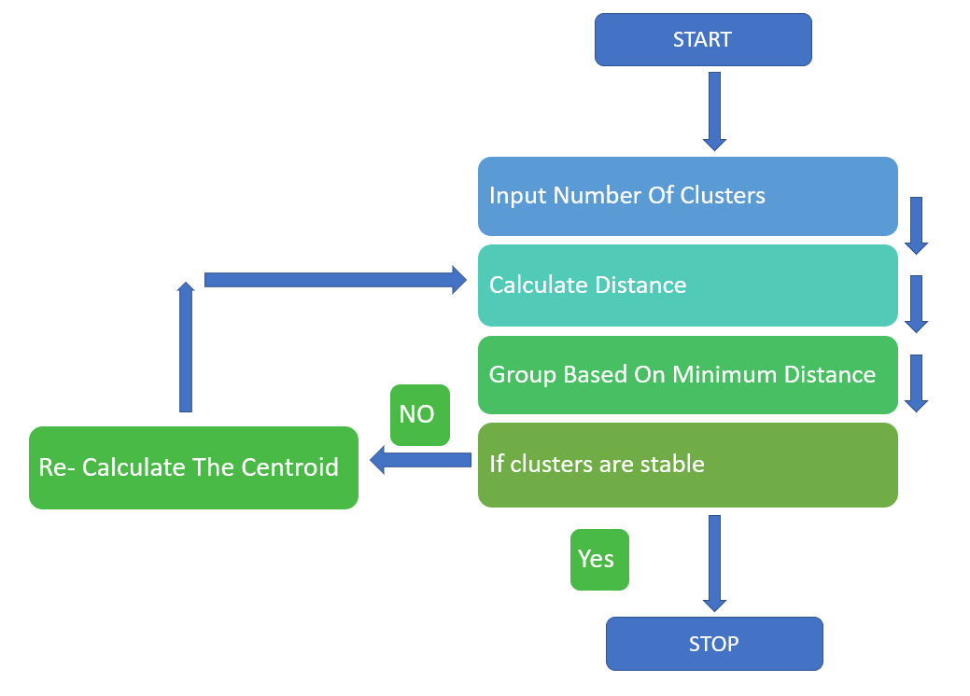
Types of Clustering:
Exclusive Clustering – Two or more groups or clusters which do not overlap.
2) Overlapping Clustering – Two or more groups or clusters that overlap.
3) Hierarchical Clustering – It builds the hierarchy of clusters.
Flow of K-Means Algorithm

Slide 5
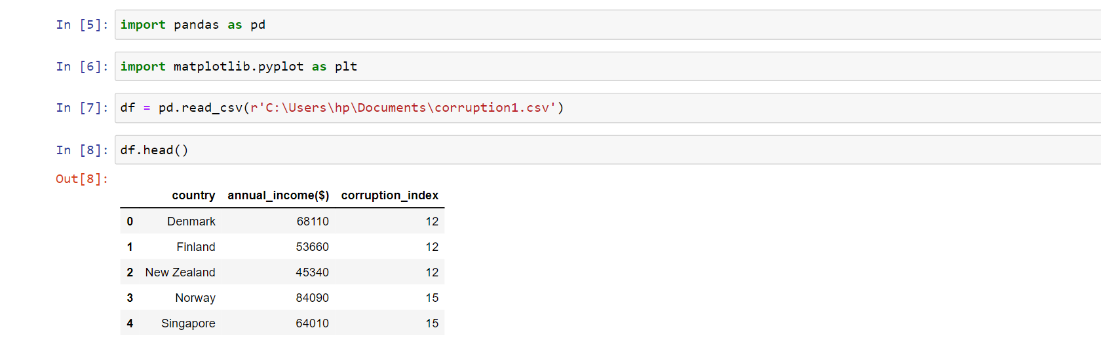
Import require packages:
Dataset:
1) Dataset contains Attribute (Country name($), Country annual income , Corruption index)
2) It contains 110 countries record.

Slide 6
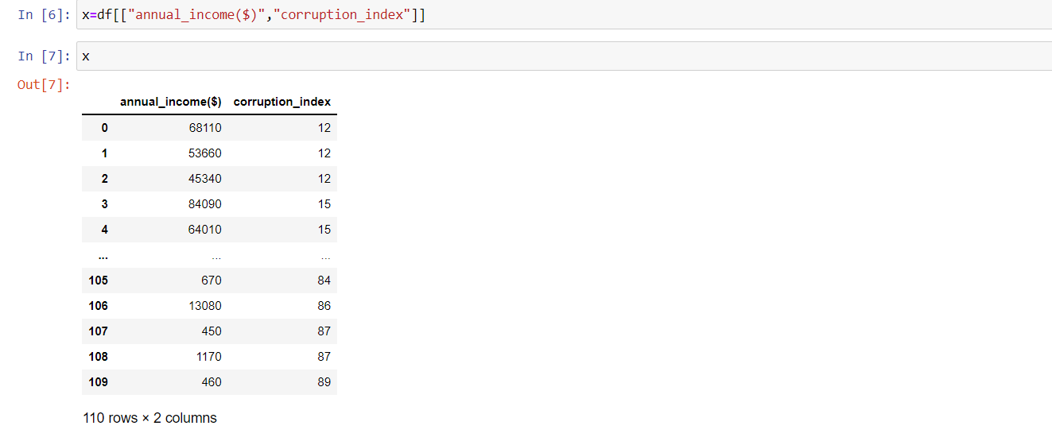

Slide 7
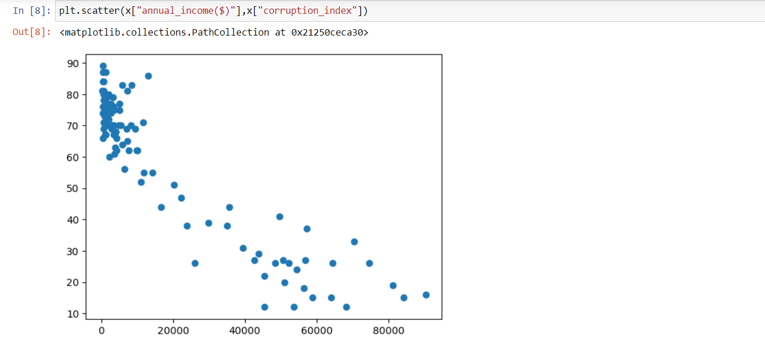
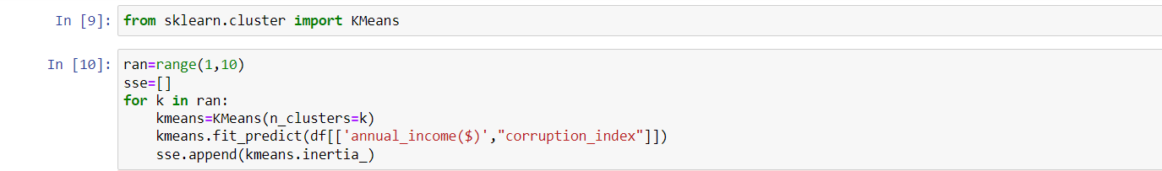

Slide 8
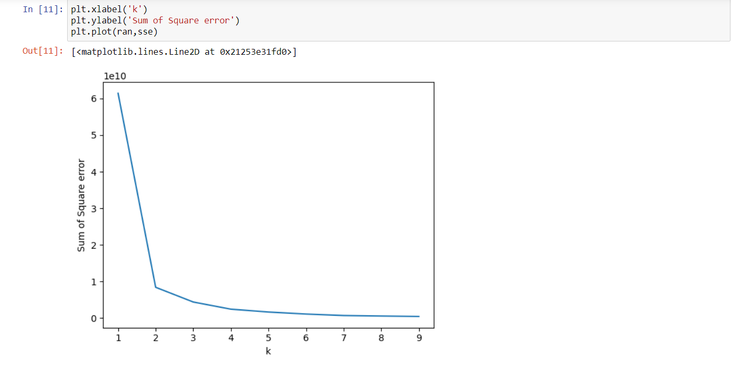
Elbow Method:

Slide 9
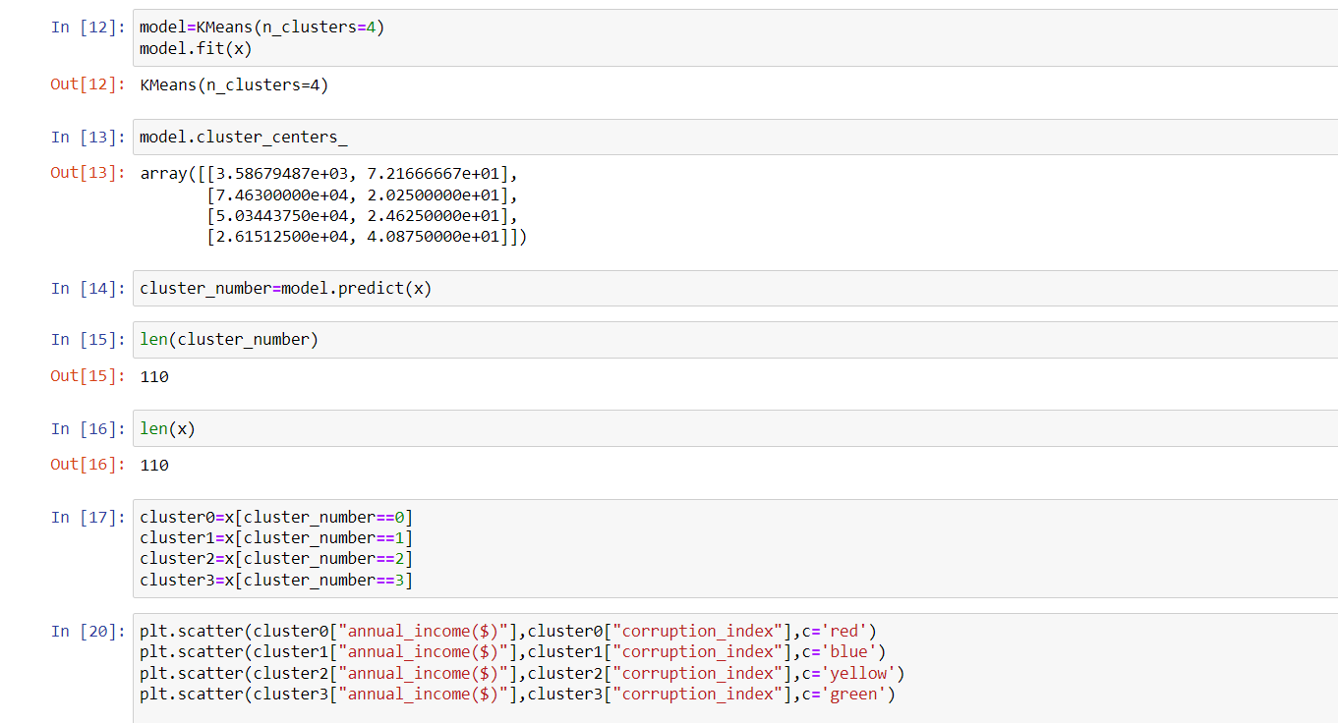

Slide 10
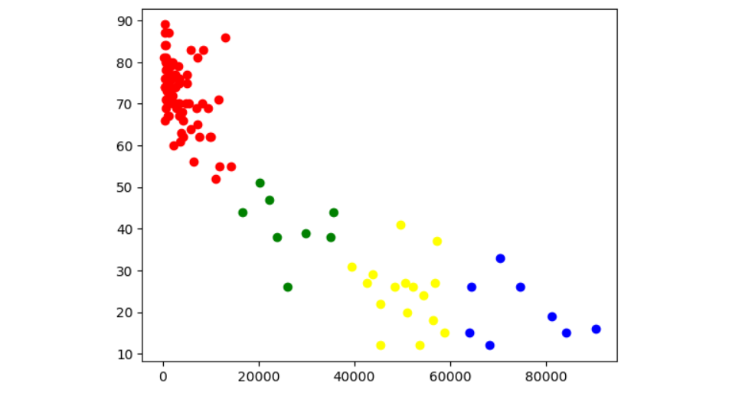
Conclusion: I divide the cluster into four parts 1) High 2) Medium High 3) Medium Low 4) Low 1) In the red cluster the annual income of countries is low & the corruption index is very high 2) In the green cluster the annual income is moderately low & the corruption index is moderate 3) In the yellow cluster the annual income is moderately high & the corruption index is quite low 4) In the blue cluster the annual income has a wide range all towards the higher side & the corruption index is quite low Overall from all clusters it is conclude that the countries with low income have high corruption index
corruption_index
annual_income($)

Slide 11


